Slide 1
El Modelo de Programación de CUDA
Pedro Alonso y Adrián Castelló
Universitat Politècnica de València

Slide 2
CUDA_C_Programming_Guide
Graphics Processing
General Purpose Parallel Computing
“…the programmable Graphic Processor Unit or GPU has evolved into a highly parallel, multithreaded, manycore processor with tremendous computational horsepower and very high memory bandwidth…”

Slide 3
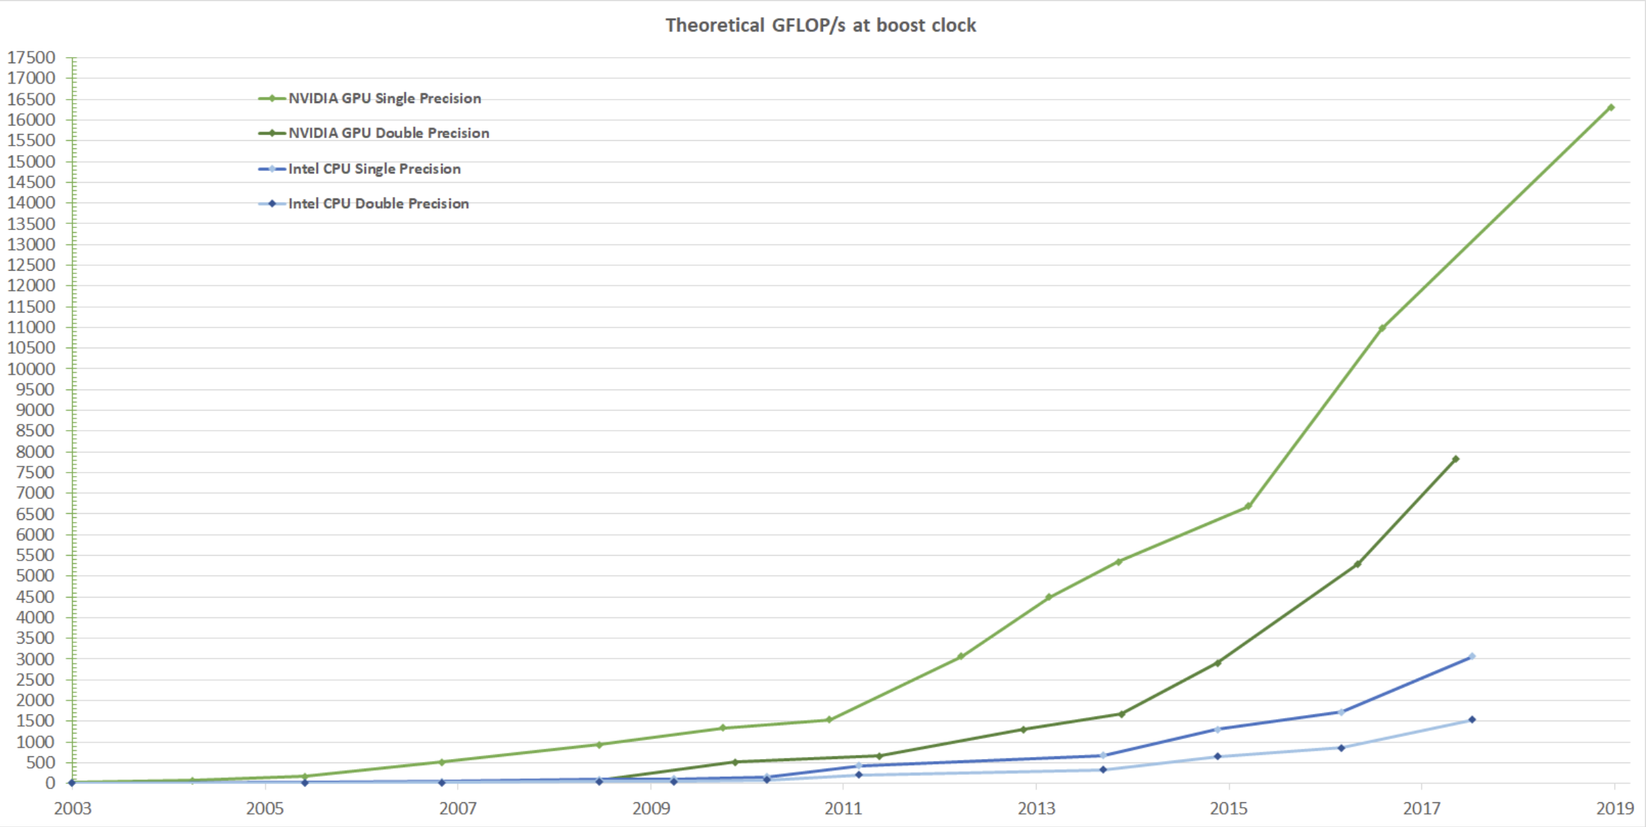
Motivation: Impressive Gflops?

Slide 4
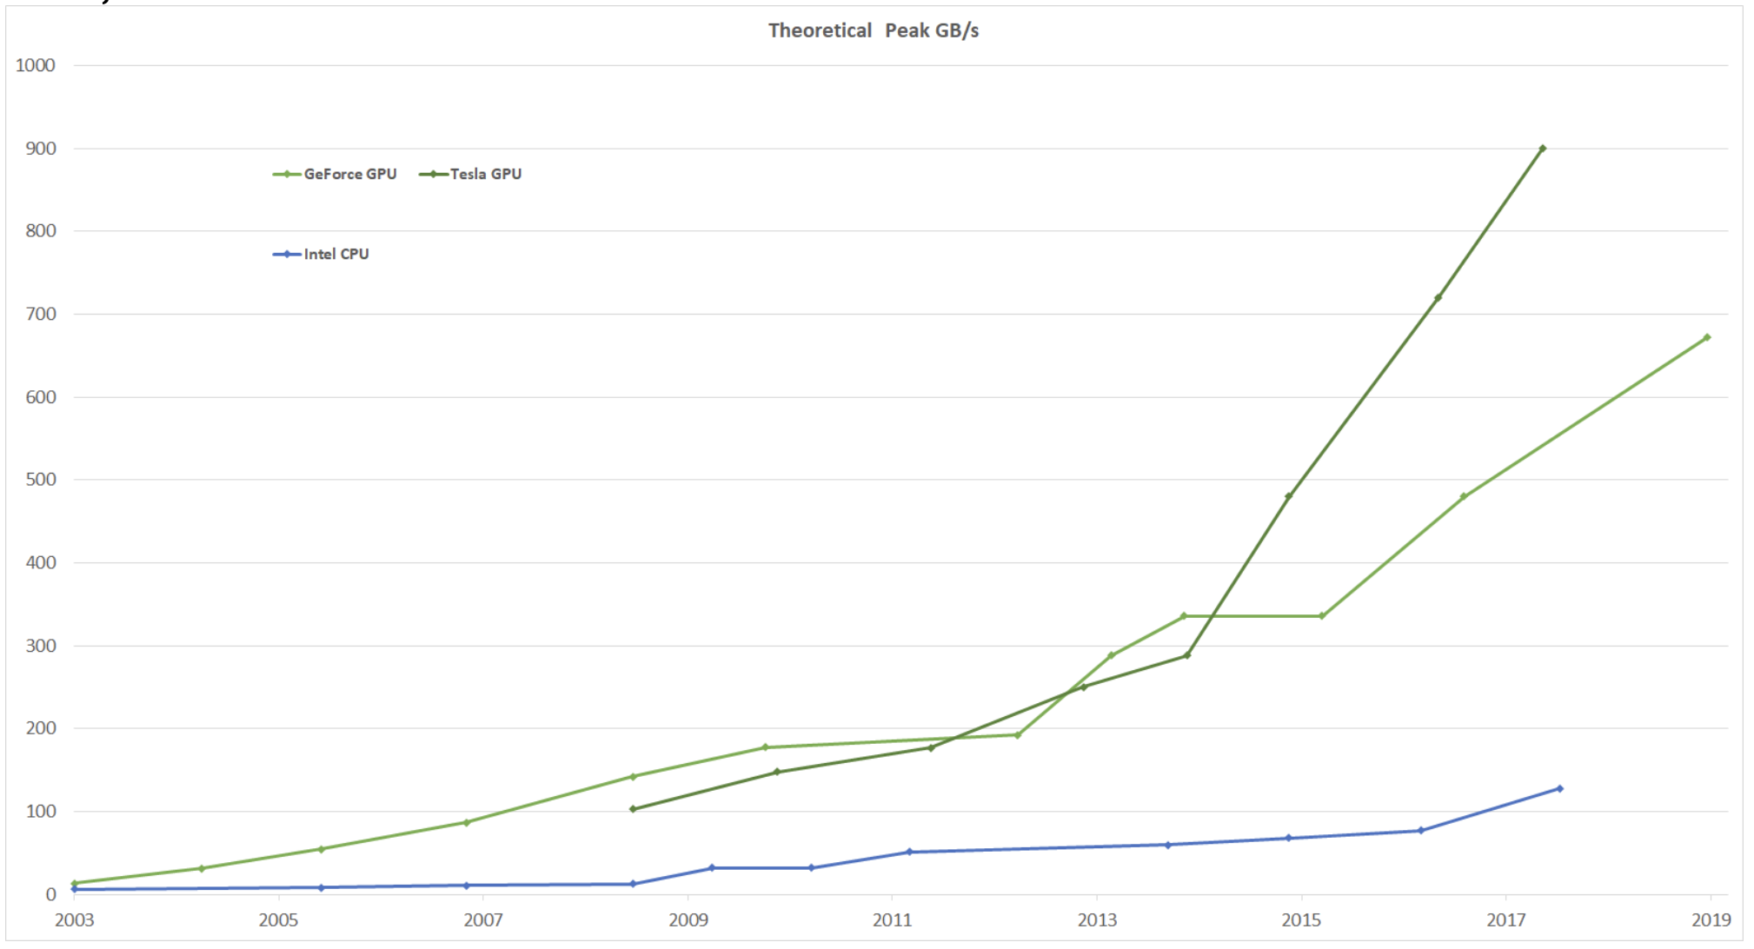
Motivation: Impressive Bandwidth?

Slide 5
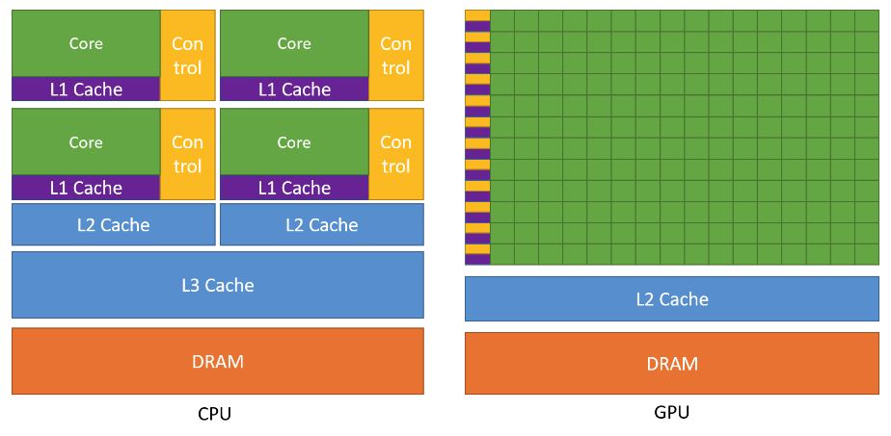
Transistors for processing
Control
Computing

Slide 6
Reasons for GPGPU Computing
Well-suited if there is high arithmetic intensity and high ratio arithmetic operations/memory operations.
Example: O(n³) flops like Matrix-Multiplication.
Because the same program is executed for each data element, there is a lower requirement for sophisticated flow control.
no branch prediction and no speculative execution.
Because it is executed on many data elements and has high arithmetic intensity, the memory access latency can be hidden with calculations instead of big data caches.

Slide 7
Reasons for GPGPU Computing
GPU is especially well-suited to address problems that can be expressed as data-parallel computation and process large data sets
Mesh representing the discretization of a bone for prediction of bone strength and osteoporosis disease. It consists of 30 x 10⁶ cubical elements.

Slide 8
CUDATM: a General-Purpose Parallel Computing Architecture
In November 2006, NVIDIA introduced CUDATM (Compute Unified Device Architecture):
New parallel Programming Model
a general purpose parallel computing platform (new Instruction Set Architecture)
CUDA uses C as a high-level programming language

Slide 9
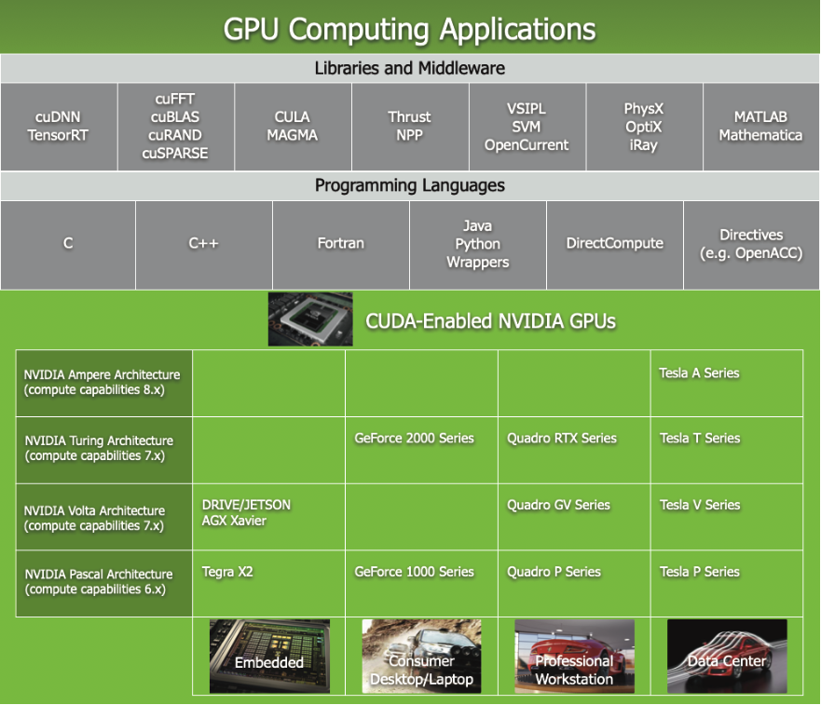
CUDATM: a General-Purpose Parallel Computing Architecture

Slide 10


CUDATM: a General-Purpose Parallel Computing Architecture
NVIDIA Libraries:
CUFFT
BLAS (Basic Linear Algebra Subprograms): CUBLAS
Example of matrix multiplication in CPU and GPU

Slide 11
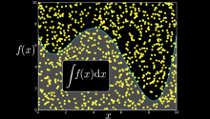
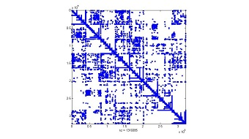

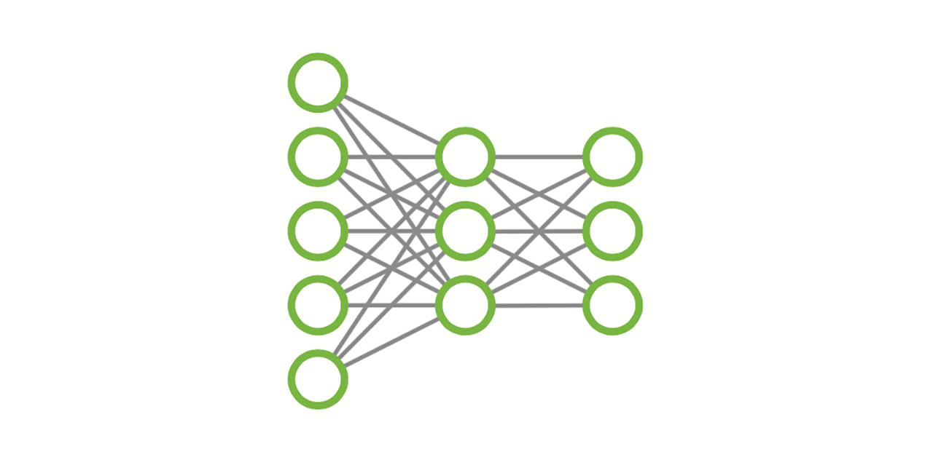
CUDATM: a General-Purpose Parallel Computing Architecture
NVIDIA Libraries:
CUFFT
BLAS (Basic Linear Algebra Subprograms): CUBLAS
CURAND
CUSPARSE
NPP (NVIDIA Performance Primitives)
CUDNN

Slide 12


CUDATM: a General-Purpose Parallel Computing Architecture
NVIDIA Libraries:
CUFFT
BLAS (Basic Linear Algebra Subprograms): CUBLAS
CURAND
CUSPARSE
NPP (NVIDIA Performance Primitives)
CUDNN
LAPACK Libraries:

Slide 13
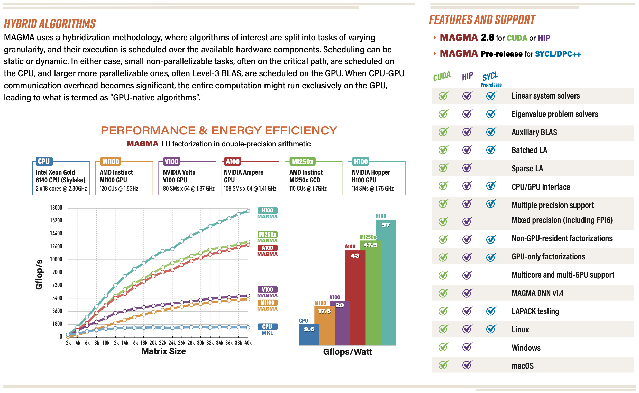

Slide 14
CUDATM: a General-Purpose Parallel Computing Architecture

Slide 15
Matlab and GPUs

Slide 16

CUDATM: a General-Purpose Parallel Computing Architecture

Slide 17
CUDATM: a General-Purpose Parallel Computing Architecture

Slide 18
A Scalable Programming Model
The challenge is to develop application software that transparently scales its parallelism to leverage the increasing number of processor cores
The CUDA parallel programming model is designed to overcome this challenge with a low learning curve for C programmers
CUDA guides the programmer
to partition the problem into coarse sub-problems that can be solved independently in parallel by blocks of threads,
and each sub-problem into finer pieces that can be solved cooperatively in parallel by all threads within the block
Each block of threads can be scheduled on any of the available processor cores, in any order, concurrently or sequentially, so that a compiled CUDA program can execute on any number of processor cores (automatic scalability)

Slide 19
Multithreaded CUDA program
Block 0
Block 1
Block 2
Block 3
Block 4
Block 5
Block 6
Block 7
GPU with 2 MP
MP 0
MP 1
GPU with 4 MP
MP 0
MP 1
MP 2
MP 3
MP 0
MP 1
Block 0
Block 1
MP 0
MP 1
MP 0
MP 1
Block 0
Block 1
Block 2
Block 3
MP 0
MP 1
Block 2
Block 3
MP 0
MP 1
MP 0
MP 1
Block 4
Block 5
Block 6
Block 7
MP 0
MP 1
Block 4
Block 5
MP 0
MP 1
Block 6
Block 7

Slide 20
Kernels
CUDA C extends C by allowing the programmer to define C functions called kernels.
A kernel is executed N times in parallel by N different CUDA threads.
Syntax example of a C function definition:
void VecAdd(float* A, float* B, float* C)
{
...
}
Syntax example of a C function call:
VecAdd( A, B, C);

Slide 21
Kernels
CUDA C extends C by allowing the programmer to define C functions called kernels.
A kernel is executed N times in parallel by N different CUDA threads.
Syntax example of a kernel definition:
__global__ void VecAdd(float* A, float* B, float* C)
{
...
}
Syntax example of a kernel call:
VecAdd<<<1,N>>>( A, B, C);

Slide 22
Kernels
Each thread that executes the kernel is given a unique thread ID.
This Thread ID is accessible within the kernel through the built-in threadIdx variable.

Slide 23
Thread Hierarchy
threadIdx is a 3-component vector.
Threads are arranged into one-dimensional, two-dimensional or three-dimensional blocks of threads.

Slide 24
Thread Hierarchy
Blocks are organized into a one-dimensional, two-dimensional, or three-dimensional grid of thread blocks.
The number of thread blocks in a grid is usually dictated by the size of the data being processed.
The number of threads per block and the number of blocks per grid specified in the <<<...>>> syntax can be of type int or dim3.
Each block within the grid can be identified by a one-dimensional, two-dimensional, or three-dimensional index accessible within the kernel through the built-in blockIdx variable.

Slide 25
Thread Hierarchy

Slide 26
Thread Hierarchy
A thread block size of 16x16 (256 threads), although arbitrary in this case, is a common choice.
The index of a thread and its thread ID relate to each other as
1D block: they are the same;
2D block of size (Dx, Dy): the thread ID of a thread of index (x, y) is (x + y Dx);
3D block of size (Dx, Dy, Dz): the thread ID of a thread of index (x, y, z) is (x + y Dx + z Dx Dy).
The grid is created with enough blocks to have one thread per matrix element as before.
Thread blocks are required to execute independently: It must be possible to execute them in any order, in parallel or in series.
Threads within a block can cooperate by sharing data through some shared memory.

Slide 27
CUDA Language
Language C with a minimal set of extensions
Declaration specifiers to indicate where things live
__global__ void KernelFunc(...); // kernel function, runs on device
__device__ int GlobalVar; // variable in device memory
__shared__ int SharedVar; // variable in per-block shared memory
Extend function invocation syntax for parallel kernel launch
KernelFunc<<<500, 128>>>(...); // launch 500 blocks, 128 threads each
Special variables for thread identification in kernels
dim3 threadIdx;
dim3 blockIdx;
dim3 blockDim;
dim3 gridDim;
Intrinsics that expose specific operations in kernel code
__syncthreads(); // barrier synchronization within kernel

Slide 28
Thread and block IDs
Kernel grid
Threads and blocks have IDs
So each thread can decide what data to work on
Grid DIM: 1D, 2D, or 3D
gridDim.x gridDim.y gridDim.z
Block DIM: 1D, 2D, or 3D
blockDim.x blockDim.y blockDim.z
Block ID: 1D, 2D, or 3D
blockIdx.x blockIdx.y blockIdx.z
Thread ID: 1D, 2D, or 3D
threadIdx.x threadIdx.y threadIdx.z
Block (0,0)
Block (0,1)
Block (0,2)
Block (1,0)
Block (1,1)
Block (1,2)
Block (1,1)
Thread (0,0)
Thread (0,1)
Thread (0,2)
Thread (0,3)
Thread (1,0)
Thread (1,1)
Thread (1,2)
Thread (1,3)
Thread (2,0)
Thread (2,1)
Thread (2,2)
Thread (2,3)
Thread (3,0)
Thread (3,1)
Thread (3,2)
Thread (3,3)

Slide 29
CUDA Kernels
One kernel is executed at a time on the device (since version 3.0 and for some devices, kernels can be executed concurrently on the same device)
Many threads execute each kernel
Each thread executes the same code on different data based on its threadID
threadIdx.x
0 | 1 | 2 | 3 | 4 | 5 | 6 | 7
. . .
float x = input[threadIdx.x];
float y = function(x);
output[threadIdx.x] = y;
. . .

Slide 30
Organization of concurrent threads
Threads are grouped into thread blocks
Kernel = grid of thread blocks
Thread Block 0
Thread Block 1
Thread Block N-1
threadIdx.x
0 | 1 | 2 | 3 | 4 | 5 | 6 | 7
threadIdx.x
0 | 1 | 2 | 3 | 4 | 5 | 6 | 7
threadIdx.x
0 | 1 | 2 | 3 | 4 | 5 | 6 | 7
. . .
float x = input[threadIdx.x];
float y = function(x);
output[threadIdx.x] = y;
. . .
. . .
float x = input[threadIdx.x];
float y = function(x);
output[threadIdx.x] = y;
. . .
. . .
float x = input[threadIdx.x];
float y = function(x);
output[threadIdx.x] = y;
. . .
...

Slide 31
Thread Blocks
Threads in the same block may synchronize with barriers
__syncthreads();
Thread blocks cannot synchronize
So they can run in any order, concurrently or sequentially
This independence gives scalability:
A kernel scales across any number of parallel cores
Implicit barrier between dependent kernels
kernelA <<< nblocks, blksize >>> (a, b, c);
kernelB <<< nblocks, blksize >>> (c, d);
Kernel grid
Block 0
Block 1
Block 2
Block 3
Block 4
Block 5
Block 6
Block 7

Slide 32
Example: matrix sum C = A + B
2D Grid
2D Thread Block
A =
x x x x x x x x x x x x x
x x x x x x x x x x x x x
x x x x x x x x x x x x x
x x x x x x x x x x x x x
x x x x x x x x x x x x x
x x x x x x x x x x x x x
x x x x x x x x x x x x x
x x x x x x x x x x x x x
x x x x x x x x x x x x x
x x x x x x x x x x x x x
x x x x x x x x x x x x x
x x x x x x x x x x x x x
x x x x x x x x x x x x x
x x
x x
x x
x x
x x
x x
x x
x x
x x
x x
x x
x x
x x
i = threadIdx.x + blockIdx.x * blockDim.x
j = threadIdx.y + blockIdx.y * blockDim.y
A(i,j)
x x x x x x x x x x x x x x x
x x x x x x x x x x x x x x x

Slide 33
Example: matrix sum C = A + B
CUDA Kernel:
//cuda kernel Matrix Sum
__global__ void matrixSum( unsigned int m, unsigned int n,
double *a, double *b, double *c ) {
// Assuming lda = m
int i = blockIdx.x * blockDim.x + threadIdx.x; // Global row index
int j = blockIdx.y * blockDim.y + threadIdx.y; // Global column index
int index = j * m + i;
if( i<m && j<n ) {
c[index] = a[index] + b[index];
}
}

Slide 34
Example: matrix sum C = A + B
C function that calls the kernel:
#define BLOCKSIZE 5
void cudaMatrixSum( unsigned int m, unsigned int n,
double* d_A, double* d_B, double* d_C ) {
int row_blocks = (int) ceil( (float) m / BLOCKSIZE );
int col_blocks = (int) ceil( (float) n / BLOCKSIZE );
dim3 block( BLOCKSIZE, BLOCKSIZE ); // Size of block
dim3 grid( row_blocks, col_blocks ); // Size of grid
matrixSum<<< grid, block >>>( m, n, d_A, d_B, d_C ); // Kernel call
}

Slide 35
Example: matrix sum C = A + B

Slide 36
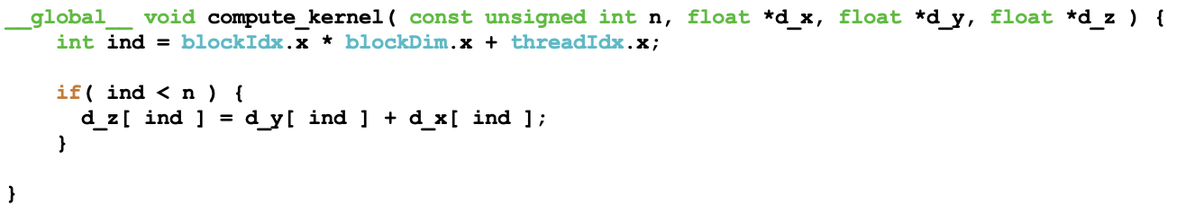
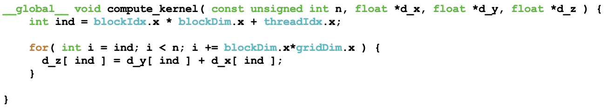
Example: linear array sum z = x + y
Issue: monolithic kernel vs. grid-stride loop.

Slide 37
Example: c = A * v
A * v = c
x x x x x x x x x x x x
x x x x x x x x x x x x
x x x x x x x x x x x x
x x x x x x x x x x x x
x x x x x x x x x x x x
x x x x x x x x x x x x
x x x x x x x x x x x x
x x x x x x x x x x x x
x x x x x x x x x x x x
x x x x x x x x x x x x
x x x x x x x x x x x x
x x x x x x x x x x x x
x x x x x x x x x x x x
x
x
x
x
x
x
x
x
x
x
x
x
x
x
x
x
x
x
x
x
x
x
x
x
x

Slide 38
Example: c = A * v
threadIdx.x
A(i,j)
A * v = c
0
1
2
3
4
0
1
2
3
4
0
1
2
3
4
x x x x x x x x x x x x
x x x x x x x x x x x x
x x x x x x x x x x x x
x x x x x x x x x x x x
x x x x x x x x x x x x
x x x x x x x x x x x x
x x x x x x x x x x x x
x x x x x x x x x x x x
x x x x x x x x x x x x
x x x x x x x x x x x x
x x x x x x x x x x x x
x x x x x x x x x x x x
x x x x x x x x x x x x
x
x
x
x
x
x
x
x
x
x
x
x
x
x
x
x
x
x
x
x
x
x
x
x
x
i = threadID.x + blockID.x * blockDim.x

Slide 39
Example: c = A * v

Slide 40
Design Goals
Enable heterogeneous systems (i.e., CPU+GPU)
CPU & GPU are separate devices with separate DRAMs
Scale to 100’s of cores, 1000’s of parallel threads
Let programmers focus on parallel algorithms
not mechanics of a parallel programming language
Use C/C++ with minimal extensions

Slide 41
Heterogeneous Programming
CUDA = serial program with parallel kernels, all in C
Serial C code executes in a host CPU thread
Parallel kernel C code executes in many device GPU threads
Serial Code
Host
Parallel Kernel A
Device
…
Serial Code
Host
Parallel Kernel B
Device
…

Slide 42
Compute Capability
The compute capability of a device is defined by a major revision number and a minor revision number.
major_revision.minor_revision
Devices with the same major revision number are of the same core architecture. The major revision number is
9 for devices based on the Hopper architecture,
8 for devices based on the Ampere architecture,
7.5 for devices based on the Turing architecture,
7 for devices based on the Volta architecture,
6 for devices based on the Pascal architecture,
5 for devices based on the Maxwell architecture,
3 for devices based on the Kepler architecture,
2 for devices based on the Fermi architecture, and
1 for devices based on the Tesla architecture.
The minor revision number corresponds to an incremental improvement to the core architecture, possibly including new features.
CUDA-Enabled GPUs lists of all CUDA-enabled devices along with their compute capability.

Slide 43
CUDA C Runtime: Device Memory
Device memory can be allocated either as linear memory or as CUDA arrays.
Linear memory:
exists on the device in a 40-bit address space of devices of compute capability 2.x
cudaMalloc(), cudaFree(), cudaMemcpy()
cudaMallocPitch(), cudaMalloc3D()
CUDA arrays are opaque memory layouts optimized for texture fetching

Slide 44
CUDA C Runtime: Device Memory

